Slide 1
Strategic Plan for Primary Care
2020-2024
V.1.10

Slide 2
Who is the plan for?
The we in the plan are:
Commissioners and providers together, commissioning in partnership with primary care
Primary care providers ( GPs, Primary Care Networks, GP Federations, community pharmacies, opticians) .
The staff working in primary care (all roles as well as leadership teams) , Voluntary and Community services and partner organisations working with primary care where it is necessary for them to understand the collective ambition of primary care in order to interface effectively with it
The ambition : that Primary Care is an equal and valued partner within our system

Slide 3
Our commitment to work together
“Our thinking starts with where people live, in their neighbourhoods, focusing on people staying well. We want to introduce new services, improve coordination between those that exist, support people who are most at risk and adapt our workforce so that we are better at meeting peoples needs”
South Yorkshire & Bassetlaw Sustainability and Transformation Plan October 2016
SYB ICS published its strategic plan in September 2019. Within that document our five Places are recognised as having plans which set out what local partners want to achieve.
Each has plans for transforming care out of hospital and across primary and community care. They include the further development of Primary Care Networks and explore the role of Federations and the opportunity for delivering primary care ‘at scale’.
Strong collaboration between CCGs, PCNs and Federations has resulted in creating efficiencies in the delivery of primary care services and avoiding duplication.
Our recent experience of Covid-19 reinforced the role of PCNs and Federations across Place, linking in to ICS infrastructure, giving practices the space to focus on delivery for local populations and communities
The role of community pharmacy, electronic repeat dispensing and remote consulting has begun to transform the interface between the public and primary care.
There are a range of groups where partners come together to collaborate at a system level, giving both space and focus for partnership working between NHS, Local Authority and key stakeholders
“Our vision is for everyone in South Yorkshire & Bassetlaw to have the best possible start in life, with support to be healthy and live well , for longer”
South Yorkshire & Bassetlaw Integrated Care System September 2019
Four Themes
Developing a population health system
Strengthening our foundations
Building a sustainable health and care system
Broadening and strengthening our partnerships to increase our opportunity
Guiding Principles SYB ICS September 2019
Ambitious for our citizens, patients and staff .
Building constructive relationships with partner organisations, groups and communities.
Do work once and avoid duplication, making best use of our resources.
Our work and actions will take place at the most appropriate level and be as local as possible.
No Place will be worse of as a result of our shared action.

Slide 4
Why have a SYB System Level Strategic Plan for Primary Care?
It is necessary to have a strategic plan against which the development of sustainable primary care across South Yorkshire and Bassetlaw takes place so that enabling support can be co-ordinated and that primary care organisations are aware of the type of support that will be available.
This strategic plan will be regularly sense-checked in the context of the national direction of travel for the NHS and developments happening across the SYB footprint and within the 5 Places. For SYB to best deal with the unprecedented direct and indirect long term consequences of the Covid-19 pandemic, resources (part of which will be investment) ) must flow from acute/secondary to primary/community in response to activity - activity must be appropriately resourced at point of delivery. This requires movement away from traditional fair shares to a more targeted approach for certain populations
An emerging theme for the basis of this strategic plan has been the concept of ‘layering’ i.e. which activities and developments are most efficiently and effectively done at different levels of scale;
Individual contractors/providers
Locality/Primary Care Network
Groupings of Primary Care Networks with specialist interest or service delivery across a wider patch
Providers at scale including Federations
Place/CCG including Integrated Care Partnerships/Accountable Care Partnerships
SYB / Integrated Care System
In order to keep the strategy inclusive and to achieve ownership, a number of primary care principles have been developed against which all plans for primary care based provision in SYB will be aligned. These principles were agreed through a series of workshops attended by representatives of key primary care organisations and partners and align well with the ICS guiding principles developed with wider system partners in 2019.
These primary care principles are the foundation of this strategic plan which describes our ambitions for primary care and the expected outcomes to be delivered.
How primary care achieves these outcomes will be decided at the appropriate layer, recognising the concept of ‘layering’ and the principle of subsidiarity where decision making and empowerment are devolved to the most appropriate lowest level across our ICS.
Organisational alignment vs integration – working through Covid has effectively achieved integrated teamworking at a pace and scale not envisaged before. Covid-19 has developed new ways of working for us, many of which we will now embed. This strategy therefore supports a direction of travel toward more integrated and seamless working at Place, developing more collaborative approaches to delivery.
Notes:
SLIDE UPDATED WITH COMMENTS FROM BEN JACKSON

Slide 5
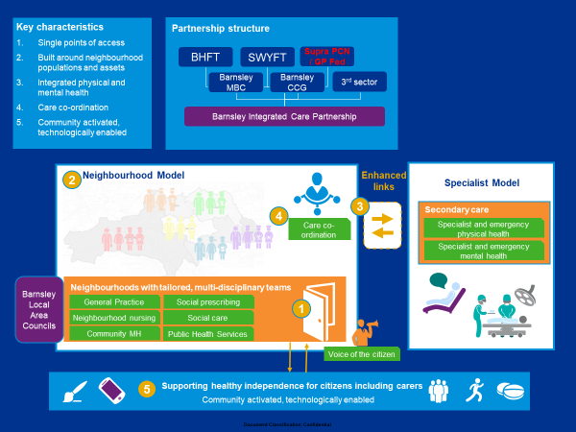
Place Partnerships - Barnsley
Improving access During COVID-19 significant changes were made to patient management in general practice with the majority of patients being supported remotely by telephone and/or video consultation. Whilst some face to face appointments are essential this has acknowledged that patient care can be provided in these different formats and should be sustained.
Developing the primary care workforce Beyond the core workforce required to deliver primary care services, there is a need to ensure that the workforce of the future have the skill to respond to a wider profile of services. Workforce plans have been developed at a PCN level, they will have at their core, principles of team working and team based competencies, enabling the growth of a general set of skills supported by specialist roles and training as required.
Population health management The CCG will continue to expand the GP led, multidisciplinary, case management of patients at highest risk of adverse health outcomes through neighbourhood teams development. These arrangements will be reviewed once more detail is available in relation to a network specification which is being developed nationally. Locally a scheme has been developed with PCN clinical directors to support networks to identify gaps in their population health requirements and develop support to meet these requirements locally.
Delivering timely, effective local integrated care and support General practice will work as part of an integrated team with the aim of avoiding unnecessary admissions to hospital and support and maximise timely discharge.
Helping people to live a healthy and independent life Primary and community services play a key role in facilitating secondary prevention for those with chronic conditions. This has and will continue to be a focus and will help to tackle health inequalities across the borough.

Slide 6
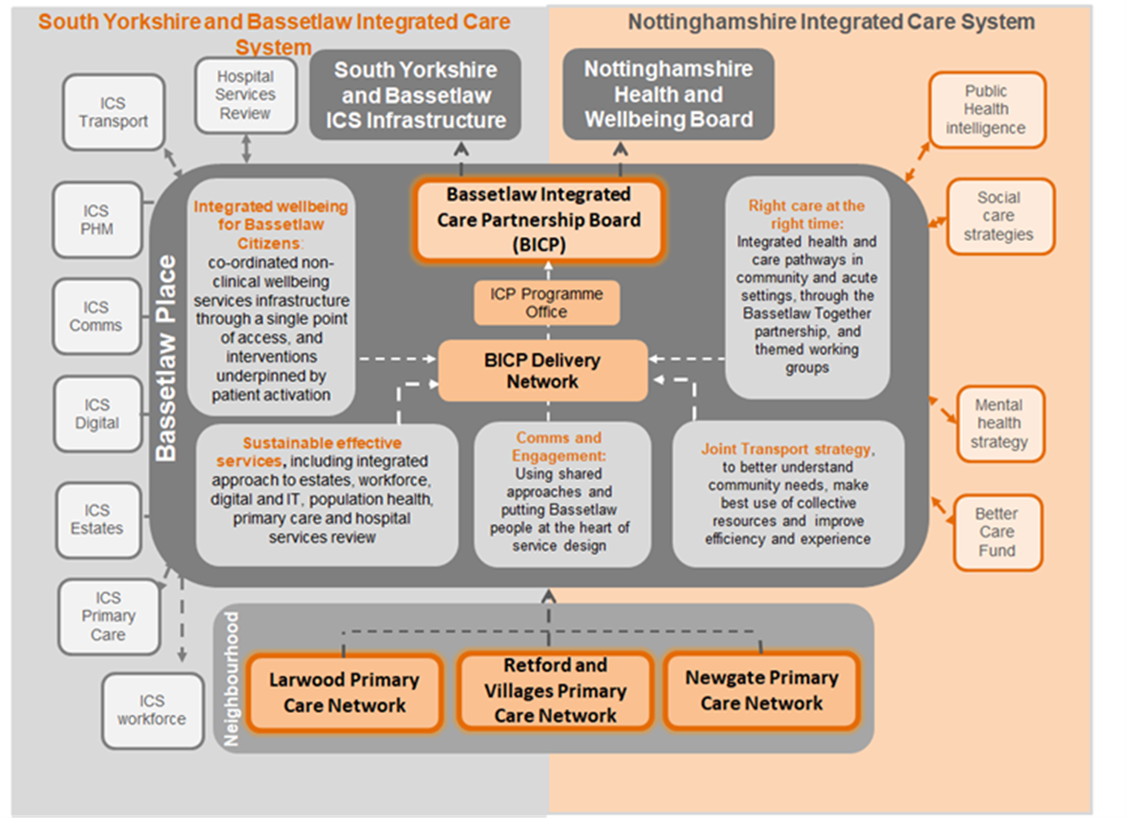
Place Partnerships - Bassetlaw
Focus on Reducing Health Inequalities
The Bassetlaw ICP continues to develop momentum to galvanise our local skills and capabilities across all sectors to support our shared ambition to reduce health inequalities and promote health and wellbeing outcomes for local people. Our PCNs are at the vanguard of these efforts, working with partners to develop local integrated teams designed to meet the specific needs of their populations and creating new ways to embed our focus on health inequalities.
Maintaining Place Resilience and Building Partnerships
We have focussed our efforts to meeting the challenge of COVID today recognising the impact on local health and care needs tomorrow. We have continued to work across partners throughout the pandemic through established escalation frameworks within Bassetlaw, as well as across, partner organisations within the SYB as well as Nottinghamshire footprint.
Promoting New Ways of Working
Our PCNs and partners across health, care, local authority, voluntary and community sectors continue to work collaboratively to identify opportunities to add value and improve outcomes for local people. This includes developing the use of digital solutions (e.g. e-Healthscope, online and virtual consultations, digital literacy, PKB), adapting flexible use of estates (e.g. Hot Hub sites), developing flexible workforce resources (e.g. use of ARRS to support care coordination, LINK workers, pharmacy and paramedic support), supporting new ways of working (e.g. weekly Place based discussions across all partners), and progressing with service transformation (e.g. mental health, urgent and same day services, out-reach support for BAME and high risk patients).

Slide 7
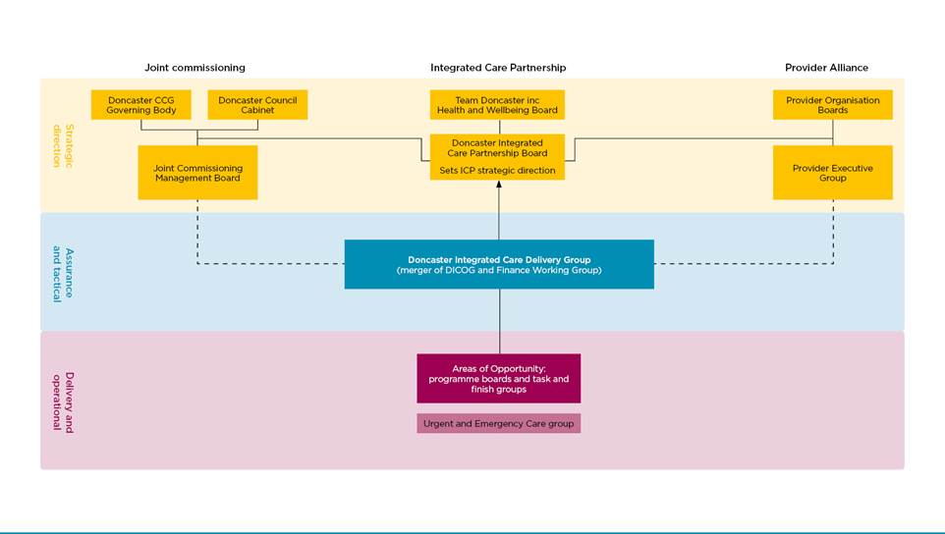
Place Partnerships - Doncaster
As a Place partnership every opportunity will be taken to ensure that the learning from and improvements made through the Covid-19 response are evaluated and maintained as part of the recovery and reset process. A number of principles have been agreed to support this which align well with the SYB Strategy for Primary Care, including;
Where appropriate; “Digital First” should be considered and we will adopt a locality approach to all recovery and reset.
Our approach will be guided by innovation and engagement and leadership of the front line. We will learn from the accelerated decision making processes during Covid-19 response.
We will learn from workforce and estate changes made during the Covid-19 response, our recovery and reset should be sustainable and based upon a future demand model.
We will be sensitive to staff commitments and wellbeing.
Doncaster Integrated Care Partnership May 2020

Slide 8
Place Partnerships - Rotherham
Key priorities for 2020/21 forwards …

Slide 9
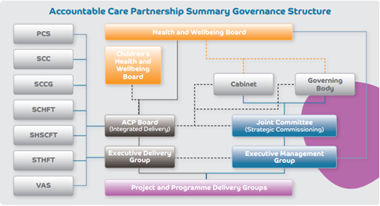
Place Partnerships - Sheffield
Primary care will remain resilient through the wrap around infrastructure supporting PCN’s and practices in Estates, Digital, Workforce and Financial priorities.
Covid-19 – addressing winter pressures, flu and the second surge in general practice with responsive support, hot and cold hubs will continue to mobilise matching capacity to demand and delivering vaccination programmes.
Primary Care Access- We’ll work to create equitable , joined up access to primary care both in and out of hours ensuring an integrated approach across practice, PCN and citywide footprints and with partner organisations.
Planned care- For people needing non-emergency care, we are taking a joined-up approach across primary and secondary care including integrated working between generalist and specialist.
Community and supporting people at home The connections between our community-based services will be clear and people will understand how different services work together. These connections are strengthening.
Workforce wellbeing we will support the primary care workforce with additional roles and focus on staff retention, training and development. We will continue to look after our staff health and wellbeing.
PCN Development we will focus on the co-ordination of care and support for patients with escalating and complex physical , mental and social care needs across disciplines and organisations.
Reducing Health Inequalities through support and investment in areas of high deprivation and greatest need.

Slide 10
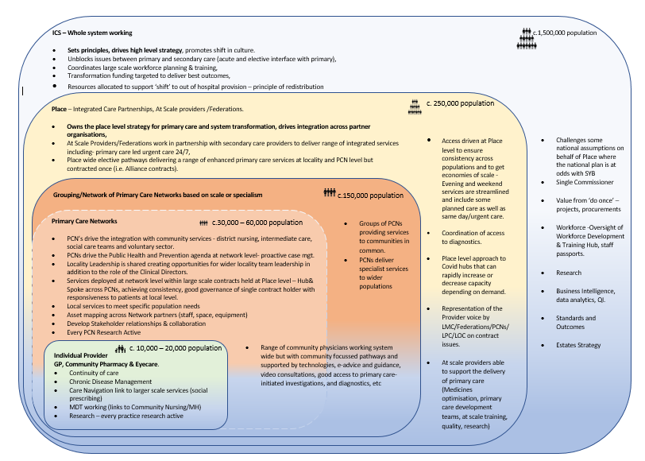
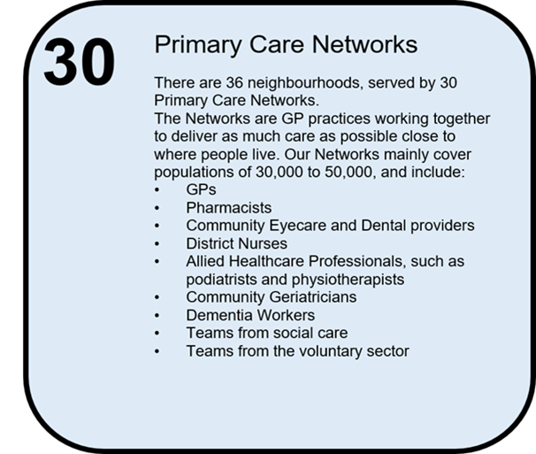
Layers of scale
The layering principle will focus thinking on what is best delivered at each level, and therefore where resources should be directed.
Valuable building blocks will be augmented rather than redesigned.
Provider organisations and population sizes in this model may vary to reflect geographical size and local infrastructure.
Notes:
Need to include dental in provider box (1 box)
Need to reduce population size to c 120,000 in Grouping 3rd box – Bassetlaw 120k pop

Slide 11
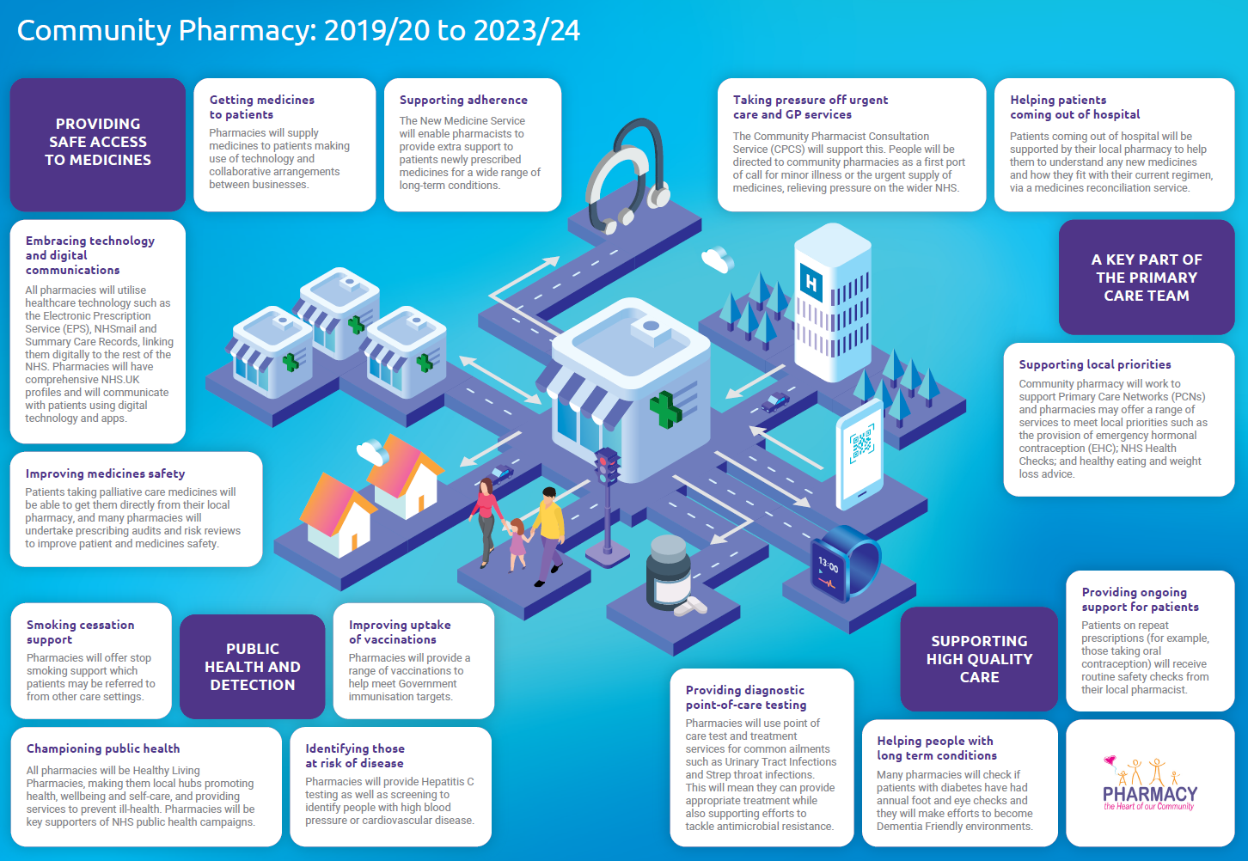
Community Pharmacy Working across layers of scale
2020/21 will see the strengthening of foundations for a more integrated, clinically focused offer in community pharmacies;
building capacity and capability;
testing new services for potential future commissioning; and
embedding and building on those commissioned in 2019/20.
We will also see greater integration with General Practice.
NHS England and NHS Improvement will support community pharmacy to work closely with GP partners, aligning incentives between the two sectors and in gaining GP support for the expansion of the NHS Community Pharmacy Consultation Service.
In turn, contractors will need to continue to develop collaborative local arrangements to underpin these new ways of working.

Slide 12
Learning from our responses to Covid-19
The Covid-19 pandemic has taught us that in all Places the health and social care sector can work together in a flexible, permissive and more productive way when facing a crisis. This has resulted in an acceleration of transformational work, new modelling, and significant digital enablement (including managing governance and IG challenges).
During Covid-19 we have seen an unprecedented flexibility and agility of the workforce.
A key principle of our strategy is that we sustain and develop these achievements.
A major challenge will be avoiding regression back to the old norm. One of the positives of the Covid-19 experience has been the gifting of an opportunity for us to use as a foundation many of the changes made. But we recognise that these achievements were mostly born out of providers being asked to work flexibly in the spirit of trust.
If we describe these as the ‘current normal’ then the next evolutionary step is now the ambition.
The new normal should not therefore be about returning to the past. A care system that has learned how to respond as a System rather than as individual organisations takes us a giant step forward. An epidemic also highlights the importance of population health approaches to understanding and addressing people’s needs, albeit on a drastically reduced timescale. We should therefore look to a future in which:
The needs of any given local population will have been reshaped by the initial and ongoing responses to the pandemic, its impact on delivery of services and the needs of our citizens – recognising and responding to this through the emergent population health management programmes will be critical.
People’s ability to self-care and to rely on local support networks will have been highlighted and needs to be reinforced alongside which new strength-based approaches to community organising will have been demonstrated and should be seen as a contribution to addressing some of the wider determinants of health including low-level mental health needs, loneliness and social isolation or other vulnerabilities.
Primary, community health and social care services will have had an opportunity to work more closely together as people choose not to go to hospital for non-Covid-19 needs, something to be harnessed and refined in the context of local needs.
We will have had opportunity to work with our communities to adapt behaviour and question traditional access routes into receiving healthcare, resulting in a stepped change in our thinking about how high quality safe care can be provided in new ways and in new settings.

Slide 13
Reducing inequalities, protecting the most vulnerable
Covid-19 has further exposed some of the health and wider inequalities across our system, in order to address these we will increase the scale and pace of progress in reducing health inequalities , delivering services inclusively and strengthening leadership and accountability across each ‘layer of scale’;
We will co-design local services and support, working with local voluntary sector, community leaders and groups within each Place, and/or within Places with the highest health inequalities, to address their greatest health inequality challenges.
Our Leadership and OD programme will be expanded to further encourage and support resilient leadership from within a wider multidisciplinary PCN workforce.
We will ensure our patients and citizens are empowered to access services that meet their needs, by making available digital routes to seeking support , advice and guidance that are easily accessible; building confidence in their use and promoting self care.
When developing access to primary care services we will consider creation of efficiency and value for money alongside scalability.
We will shift our focus and resource to recognise that system resilience is dependent on the effective delivery of the vast majority of health and care transactions located within a non-acute setting. We will shift our collective thinking as an ICS as well as our collective resources in greater recognition of this.
Notes:
“We will co-design local services and support, working with local voluntary sector, community leaders and groups within * each Place, to address their greatest health inequality challenges” OR Do we mean “within* Places with the highest health inequalities…...”
this is an interesting question - It has been suggested we may need to focus sometimes on the Place with the most challenges, but then every Place will have challenges and inequalities. As a system level strategy should we be saying that at times and depending on the issue or targeted funding we may need to do the latter, but generally would do the former ?
“When developing access to primary care services we will consider creation of efficiency and value for money alongside scalability” .
Needs further consideration

Slide 14
Workforce 1
Following the publication of the Interim People Plan last year and the publication of We Are the NHS People Plan 2020/21, we will produce a Primary Care People Plan reflecting the key themes of:
Looking after our people
Belonging in the NHS
New ways of working
Growing for the future
Working with our CCGs ,through our Primary Care Networks(PCN) and Federations and with our VCSE and partner organisations we will maximise the opportunities to recruit additional staff with a wide range of skills into the primary care workforce. Maximising on the opportunities presented through the PCN DES Additional Roles Reimbursement Scheme (ARRS). This will include assessing and presenting opportunities for network roles across PCNs, VCSE and secondary care.
There will be a range of actions to improve recruitment and retention of the primary care workforce, recognising the need to provide the necessary support to build resilience within our current workforce and with a focus on equality, diversity and inclusion.
We will embrace the development of non-traditional roles, staff with advanced clinical skills will work across PCN footprints, or even larger localities, and in some cases will be supported to rotate between organisations building the individuals expertise and helping develop mature relationships between SYB partner organisations.
Workforce planning being done at Place/Network level will be supported through a Whole System Partnership approach (see following section) with the goal of mapping and shaping workforce data from across organisations in a consistent way that is rooted in population health needs and balances the strategic direction set by the ICS, whilst being sensitive to local priorities.
The Primary Care People Plan will build upon existing assets and workstreams including SYB Workforce Development and Training Hub. The Hub will play a key role in supporting the workforce training and development requirements that emerge from the Whole System Partnership modelling.
In order to grow our workforce all Primary Care Networks will be encouraged to participate in some way in the training of new advanced clinical roles, additional placements within a primary care setting will be created and practices supported to engage in training where they have not done so before.
Leadership development – Clear leaders or potential leaders of the future have emerged throughout the pandemic, from a range of backgrounds with a range of skills and experience who have demonstrated the ability to lead, motivate and support colleagues. These individuals must be supported either at local, Place or system level, with a focus on creating a culture of compassionate leadership.

Slide 15
Workforce 2 - A Population Health Management approach to workforce modelling
We will use Whole System Partnership modelling to shape our workforce at a system level using centrally provided data from HEE/NHSD/NMDS and to relate this to changing demographics to get a picture of overall future workforce requirements driven by population health needs across all acute, community, primary and social care workforce across SYB, albeit at a high level.
With the increased need to work from Primary Care Networks and Place geographies, including the planning requirements for the ARRS , there will be a focus on more detailed modelling of the General Practice workforce both in respect of GP numbers, overall skill mix and the development of new roles. This will include the relationship between different layers of grades to ensure mentoring and supported career progression is factored in.
Focussed discussions/engagement exercises with each of the five Place areas will explore how partners in Place work together to develop capacity and capability amongst their combined workforce to address the changing population health needs for ‘x’…” with x being:
Children and young people;
People with mental health needs;
Our wider communities through the development of place assets;
Those who we wish to see ageing well;
People who need a hospital admission for either planned or emergency care.
The outputs from each of the five areas will then be translated into transferable intelligence enabling it to be scaled up into a system wider strategic workforce plan. This 8-9 month project will give Primary Care providers a solid basis for their workforce plans for 2021/22 and beyond.
Learning from Covid-19 will weave through each of these elements.
Primary Care providers in SYB will use the outcomes of this modelling, alongside the ‘layers of scale’ to shape their workforce plans for 2021 onwards. Governance and accountability for delivery will be strengthened with clarity of roles and responsibilities and effective oversight. Activities to increase capacity and capability will be required with a strong focus on Place.
Notes:
UPDATED SLIDE – FINAL PARA FROM BEN CHICO 12.8.20

Slide 16
Digital , Innovation and Estates
Digital progress, whilst recognised as a major enabler for most roles in the NHS, has been slow to develop due to a number of barriers. Our response to Covid-19 however produced a step change in digital advancement across primary care. What seemed aspirational, quickly became necessary with video and telephone consultations, full e-triage, e-repeat dispensing, the use of e-advice and guidance, tele-dermatology, use of IT to work remotely, all becoming the new norm. Digital connectivity between primary care, patients citizens and partner organisations has become the new norm and there will be “no going back” . Wider enabling technologies are available and their introduction at pace is an ask of this strategy.
We will be clear about the partners that need to be connected and the way in which primary care will interact within system, the emphasis being on ‘digital first’. During the Covid-19 crisis many patients have engaged more in self care/management of new and existing conditions. There is now an opportunity to put in place more ‘supported self care’ building on these new ways of working, maximising technology and supporting patients in taking greater responsibility for their health and wellbeing.
Digital Transformation is a priority for the ICS. We will utilise digital capabilities to deliver system efficiencies through alternative consultation methods (e.g. non-face to face, community and independent providers), to reduce the number of referrals to secondary care and follow up appointments, and to improve patient and staff experience.
We will work with the Yorkshire and Humber Academic Health Science Network and our partners to understand the current state, where gaps exist, and where there are further opportunities for innovation and optimisation.
As an ICS we have recognised the importance of future proofing the delivery of primary and community care through a range of interventions, including the co-ordinated investment in primary care estate. The opportunity to transform the estate is predicated on a wider vision of service integration and collaborative working to deliver the right services at the right time in the right place.
The vision for primary care relating to at-scale delivery and provision with high quality integrated services aligns with the recently submitted ICS Estates Strategy which recognised and outlined an ambition and plan of further work to identify, develop and deliver a primary care estate that is fit for purpose and aligns with and supports the delivery of priorities in key areas such as the workforce and digital agendas.
Working with our Place leads we will prioritise investment in primary care estate through the identification of a number of transformational projects which support both the overarching vision for primary care in SYB, but also support the development and delivery of modern, fit for purpose facilities identified as required within local primary care estates strategies.

Slide 17
Digital , Innovation and Estates
Reducing Inequalities in the SYB population is at the centre of our digital strategy. To achieve this we need to embed the digital capabilities and standards required to support safe, efficient, effective, integrated care. Our strategy identifies four key areas of focus:
Population health and business intelligence
Citizen empowerment and activation
Tools and services to support a safe and efficient workforce
Integrated, accessible electronic patient records
Underpinning this is the need for appropriate infrastructure, governance, innovation and culture to successfully deliver the benefits and return on our investment. We will continue to work with our primary care partners at each Place to support their efforts to deliver this vision. Our strategies to achieve this include:
Consultation with our partners at each Place to baseline and blueprint digital transformation and innovation from our Phase 1 and 2 response to Covid-19 (e.g. virtual consultations and triage, collaboration tools, and e-learning) identifying gaps, sharing best practice to create a better, more consistent experience for patients and staff across SYB.
Promoting greater integration of patient records across all care settings, including social care, the independent sector, community-based providers (e.g. community pharmacy, opticians), 111 services, single point of access, social prescribing link workers and Primary Care Networks. We are working with our partners to understand their current goals, challenges and barriers to integrated care records, and help address gaps across the system.
Co-designing an approach to digital inclusion and literacy with citizens and staff to help reduce inequalities across SYB. We will ensure that voices are heard across the population so that no one is left behind in the effort to transform services digitally. Working through Place we will implement recommendations across SYB.
Empowering patients through a common patient access platform for SYB, ensuring a consistent and joined-up experience across primary and secondary care. This aims to enable increased patient activation and supported self-management of conditions, appointments, medication and social prescribing, patient-initiated follow up, to realise our population health outcomes.
Our digital strategy will continue to identify new and innovative opportunities to automate workflows, releasing staff time for patient care, or retraining and redeploying staff. With the shift in the utilisation of spaces and workforce due to digital interventions, we will also continue to develop greater alignment between digital, estates and workforce strategies.

Slide 18
Business Intelligence
An intelligence function is essential to support population health management (PHM) , dentifying and protecting the most vulnerable and to reduce inequalities across SYB requires a well-orchestrated approach to integrated health and social care systems, data-driven intelligence, underpinned by sound governance and infrastructure.
We will both sustain and expand existing capabilities , using the existing talents of our BI teams across all our sectors- acute, primary and community.
We will examine best practice locally, regionally and nationally to understand what can learnt from other Systems, including national policy and guidance to help establish intelligence networks, develop universal data and intelligence sources which can inform decisions about where, when and how we best use our resource to maximise patient outcomes and reduce health inequalities.
This PHM goal is part of a broader ICS intelligence function required to support the data intelligence needs of the ICS while taking into consideration System, Place and Neighbourhood level requirements. Our needs include:
identifying clinically and socially vulnerable citizens for targeted interventions (e.g. flu vaccinations)
monitoring and reporting of Covid-19 (and other risks to public health)
identification of population needs, outcomes, and the wider determinants of health
risk stratification
outcome monitoring and measurement
demand and capacity analysis
predictive forecasting and scenario modelling
programme reporting and evaluation

Slide 19
High level outcomes - success looks like ...
Consistency of access to services and a coherent ‘at scale’ offer across SYB, this may require movement away from ‘fair shares’ .
Increase in the scale and pace of progress in reducing health inequalities (regularly assessing progress)
For South Yorkshire & Bassetlaw to best deal with the unprecedented direct and indirect long term consequences of the Covid-19 pandemic, resources (part of which will be investment) ) flow from acute/secondary to primary/community in response to activity - activity is appropriately resourced at point of delivery. This requires movement away from traditional fair shares to a more targeted approach for certain populations.
People in South Yorkshire and Bassetlaw are empowered to keep themselves well and self care. They are accessing high quality services in the right place at the right time.
VCSE infrastructure is the gateway to wider delivery partners to support the self-care agenda including physical activity.
As the biggest collective provider in the system general practice/primary care has a mechanism to present a strong single consistent voice at Place and System level
Leadership across localities is multidisciplinary, reflecting strong MDT working arrangements across local system partners.
Primary care services are equally accessible across our SYB footprint and delivered at appropriate scale to ensure resilience
Consistency of structure is adopted where this is possible and required to deliver consistency of outcome
Movement away from multiple contracts for each service and move toward single contracts with bespoke deliverables at local level.
Primary Care providers leading or involved in development of new pathways, not merely a recipient of activity. VCSE aiding with engagement with communities.
Through a refresh of our Long Term Plan deliverables progress we continue to support our Places, through sharing of best practice , solutions and innovations. We recognise the need for ‘numbers’ but our focus is on outcomes.
Through socialising of this strategy across the ICS we secure a greater voice for primary care across our system
Primary care is working collectively within the primary care setting and across wider provider partnerships taking advantage of economies of scale and supporting the development of integrated and seamless models of care.

Slide 20
How do we know we’re on track?
Place delivery plans
Owned by CCGs for Primary Care / LTP, GPFV, GP contract (including PCN DES), Locally Commissioned PC services.
NHSE/I delivery plans
Directly commissioned services from Community Pharmacy, Ophthalmic Opticians and Dental.
ICS delivery plans
Owned by workstreams covering the ‘three key priorities’ of Workforce, Digital and Business Intelligence.
ICS Primary Care Programme Board
LTP deliverables monitoring captures progress with delivery of national requirements across NHSE/I, CCGs and Providers (Updated post-Covid-19 with revised timescales and outcomes).
Managed by NHSEI Primary Care Team, updated by lead organisation (eg. CCGs for GP, NHSEI for Pharmacy/eyecare etc)
ToR 2020/21 refresh to ensure membership enables appropriate oversight, governance and delivery of the High Level Outcomes and adherence to the Principles and ways of working set out in this strategy.
Patient Representative Groups
Being restored to PCNs/GPs.
SHAPE tool SYB
Visual representation of services and workforce developing across PCN footprints, including GPs, Community Pharmacy. Developing workforce data , building second stage template which will include ‘new roles/ARRS’ and enhanced services described in GP PCN Directed Enhanced Service and CCG Locally Commissioned Services.

